Slide 1
EOE Grants (E-Grants)
Executive Office of Education (EOE)
Training Module:
User Access Administration

Slide 2
Agenda
Purpose of Today’s Training
Overview of User Access
Managing Users
Creating Users
Creating Roles
Changing and Removing User Roles
User access for users in multiple organizations
Other Topics
Updating User Profiles
The Address Book

Slide 3
Today’s Purpose
Beginning with grants in the 2024-25 fiscal year, grant applicants will use the E-Grants system to apply for funds for education grants in Massachusetts.
The purpose of this webinar is to train new E-Grants users who will have the role of “ User Access Administrator.”
All users are added to E-Grants by a user with the role of “User Access Administrator.” E-Grants does not have a “self-registration” feature.

Slide 4
Overview of User Access

Slide 5
User Access Administrator Role
E-Grants has user access administrators at both the State level and the Grantee level.
  A state-level “User Access Administrator” may add users for (a) State user roles and (b) Grantee user roles.
  A Grantee-level “User Access Administrator” may add any user to their own organization.

Slide 6
User Access Administrator Role (2)
A Grantee-level user access administrator may view all funding applications, invoices, and data within their own organization.
A Grantee-level user access administrator may not edit, submit, or approve funding applications or reimbursement requests in their Grantee, unless they are added for those roles.
User Access Administration

Slide 7
Designating Grantee Users
In E-Grants, Grantee users are each linked to:
an organization (such as a school organization, college, state agency, or community based-organization (CBO)
a role (or roles)
  Roles are permissions that designate what functions users can perform in the system (such as view, edit, submit, or approve).
User Access Administration

Slide 8
Tips About Roles
A role is a permission (or set of permissions) --not a title.
Multiple people can have the same role.
A single user can have multiple roles.
If more than one user is assigned a role (such as Superintendent), you only need one of those users to approve each grant.
User Access Administration

Slide 9
Funding Application Roles
Every organization must have at least one user with the following roles in order to submit a funding application in E-Grants:
Grantwriter
  Users with this role may be an organization’s Program Director, Manager, or Lead Agency Representative.
Fiscal Representative
  Users with this role must be an organization’s CFO, Fiscal Agent, Business Manager, or Bookkeeper.
Superintendent – Chief Executive
  Users with this role must be an organization’s Executive Director, President, Director (signing authority for agency), CEO, Managing Director.
User Access Administrator
User Access Administration

Slide 10
The Grantwriter Role
In E-Grants, a Grantwriter is assigned uniquely for each funding application.
Even if a organization has the same person writing all of their grants, the user will need to be assigned the grantwriter role for each funding application for which the organization intends to apply.
Note that user access will carry forward into subsequent years. Users maintain their roles in the system until they are removed by a user access administrator.
User Access Administration

Slide 11
Funding Application Update Role
The <Funding Application> “Update” role will allow a user to edit fields and budget details within a funding application.
Users with the <Funding Application> “Update” role cannot click the status change link to Grantwriter Submitted.
User Access Administration

Slide 12
Approval Roles
The Fiscal Representative has access to approve all funding applications submitted by a organization (organization).
The Fiscal Representative is reviewing the application for budgetary and fiscal compliance.
The Superintendent – Chief Executive has access to approve all funding applications submitted by a organization (organization).
The Superintendent – Chief Executive is reviewing the application as the final approver.
User Access Administration

Slide 13
Approval Roles (2)
The Fiscal Representative and Superintendent roles:
Cannot change the grantwriter's work in the funding application (the application is locked when it is sent to the approval roles).
Can use the “Create Comment” feature to provide comments to the grantwriter to make edits in the funding application. Users in approval roles can then send the funding application back to the grantwriter by “not approving” the application.
User Access Administration

Slide 14
Users in Multiple Organizations
A state-level user access administrator can assign roles to a single Grantee user in multiple organizations.
A Grantee user access administrator can only grant roles in their own organization.
User Access Administration

Slide 15
Managing Users

Slide 16
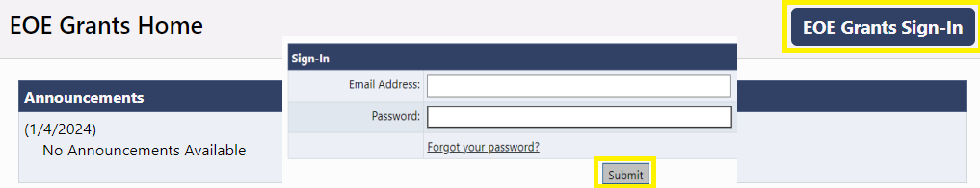
Accessing the System
The E-Grants site URL is https://masseoe.egrantsmanagement.com/
Click “E-Grants Sign-In.”
Enter your Email Address and Password. Click “Submit.”
When needed, use “Forgot your password?” to reset your password.

Slide 17
Initial User Access Administrators
This system is under construction by the same vendor responsible for developing the DESE grants management system. The transition includes the transfer of all user account information gathered by DESE (Department of Elementary & Secondary Education) staff and bulk loaded into the E-Grants portal. The names and email addresses of “initial” users who will serve as user access administrators.
Your log in information remains the same from DESE’s grant system. You can also click on “Forgot your password?” to receive an email to set up your password.
Once complete, please look for an email with instructions on how to reset your password. The email will come from:
noreply@egrantsmanagement.com

Slide 18
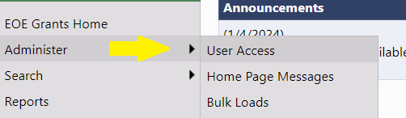
Managing Users
Users with the User Access Administrator role will have an “Administer” option on their left navigation menu.
To create or edit a user, navigate to “Administer” > “User Access.”
User Access Administration

Slide 19
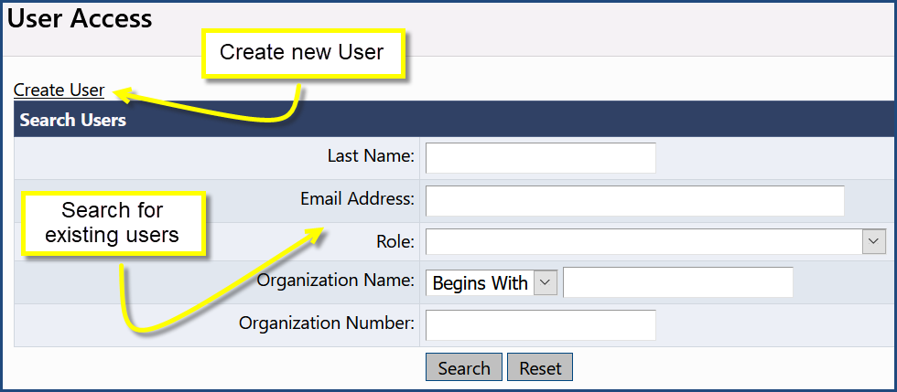
The User Access Screen
The User Access screen has two paths:
  Link to Create a New User
  Search for an existing users
User Access Administration

Slide 20
Creating a User
To create a user, click on the “Create User” link.
User Access Administration

Slide 21
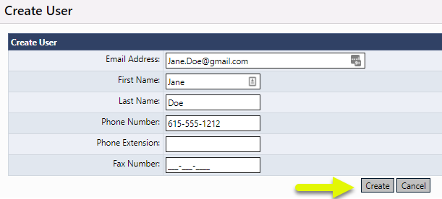
Creating a User (2)
Enter the user’s Email Address, First Name and Last Name.
Other fields are optional; the user can set these up themselves after signing in.
The system sends an email to the new user when “Create” is clicked.
User Access Administration

Slide 22
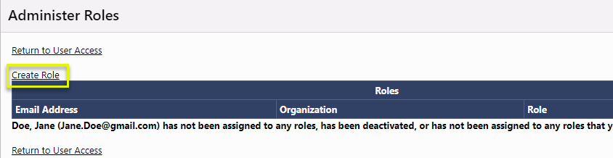
To Add Role(s)
Click on “Create Role.”
User Access Administration

Slide 23
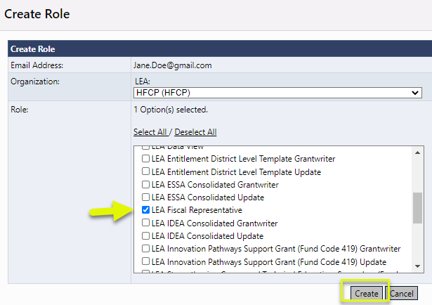
To Add Roles (2)
Leave the School at “ALL”.
Check the box(es) for the appropriate role(s). Click “Create.”
User Access Administration

Slide 24
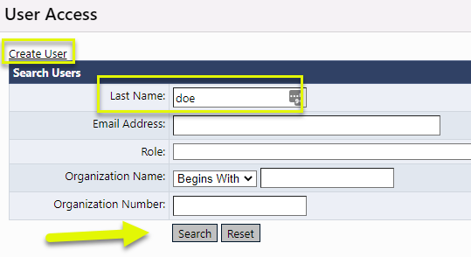
To Change Role(s)
To change, delete or add a new role for an existing user, use the search screen to locate the user. This is done from Administer < User Access screen.
User Access Administration

Slide 25
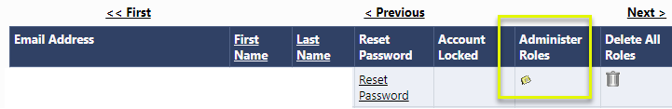
To Change Role(s) (2)
Click on the “Administer Roles” icon. (see screenshot below)
User Access Administration

Slide 26
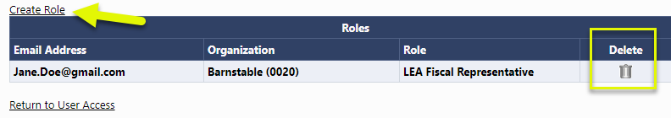
To Change Role(s) (3)
Click on the “Administer Roles” icon. (see screenshot below)
Use the “Create Role” link and/or the “Delete’ trash can icon to edit the user roles.
Some suggest that when changing a role for a user, add the new role first and then delete the old role.
User Access Administration

Slide 27
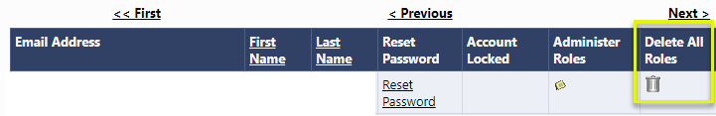
To “Delete” a User
Technically, once a user is created, the username and audit trail of that user’s actions will continue to reside in the system, even after the user no longer has access.
To remove a user’s access, use the trash can icon under “Delete All Roles.”
User Access Administration

Slide 28

Other User Access Features
A user access administrator can also:
Reset a user’s password
View user history
When creating users, be sure that you input email addresses correctly or that role holder will not receive emails generated by the system!
User Access Administration

Slide 29
Demo

Slide 30
Other Topics

Slide 31
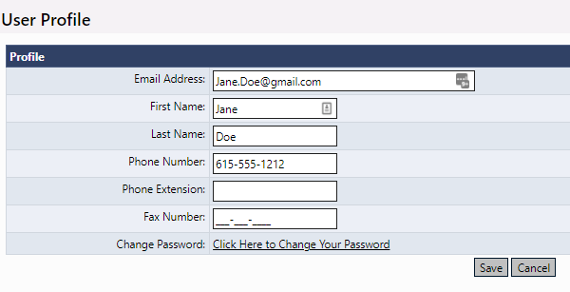
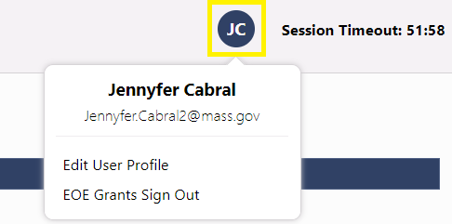
Modifying a User Profile
Each user may modify their own User Profile.
To modify your User Profile, click your initial avatar, then “Edit User Profile” to update your information or change your password.

Slide 32
To Update a User
IMPORTANT: If you need to correct a user’s email address (or other information), do not create a new account. Search for the original entry and make any edits to that account.
User Access Administration

Slide 33
Reviewing the Address Book
It is best practice to review the roles in your organization at least annually to determine if changes need to be made. A quick way to see who has roles in your organization is to access the Address Book.
The Address Book is accessed from the E-Grants main menu using the left-hand navigation.
User Access Administration

Slide 34
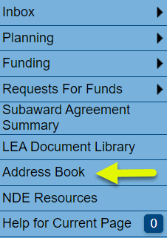
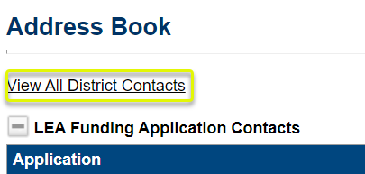
Reviewing the Address Book (2)
To review the Address Book:
Click on “Address Book” from the main menu.
Use the toggle link “View All organization Contacts” and “Return to Address Book” to view user/role information within the Grantee.
User Access Administration

Slide 35
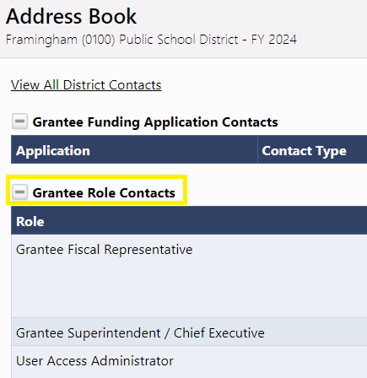
Address Book Headings
Here are some main headings of users within the Address Book that are most helpful to view user listings:
Grantee Role Contacts lists all Grantee roles with users who are assigned to each role.
User Access Administration

Slide 36
Address Book Headings
EOE’s Funding Application Contacts lists E-Grants users who have been designated as state-level contact(s) for each funding application by EOE. This is a good place to look if you have a program question about a specific funding application.
Note that user contact information (such as email address and phone number) becomes visible when clicking on the link for the name of the contact.
User Access Administration

Slide 37
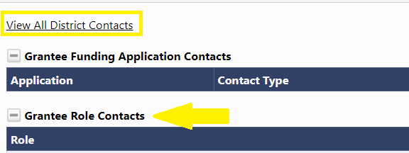
Address Book Headings
After clicking on View All District Contacts:
Grantee Contacts lists all current Grantee users arranged alphabetically by last name.
User Access Administration

Slide 38
Demo

