Slide 1
EOE Grants (E-Grants)
Executive Office of Education (EOE)
Training Module 1
General Site Navigation

Slide 2
Agenda
Users and Roles
  Funding Application Roles
System Navigation

Slide 3
Users & Roles

Slide 4
User Access Training Resources
To become an EOE Grants user, you must be added to the system by a User Access Administrator.
You may locate the name and contact information for your organization’s User Access Administrator in the EOE Grants system without logging in.

Slide 5
User Access for Go-Live (2)
To see if your organization has a User Access Administrator (logging in is not needed)
In EOE Grants, go to “Search > Organization’ and enter the name of your organization.
Click on the name of your organization.
Use the left navigation menu to access the “Address Book.”
Click on the name of the User Access Administrator to retrieve their email address and phone number.

Slide 6
Funding Application Roles
Every organization must have at least one user with the following roles in order to submit a funding application in EOE Grants:
Grantee Grantwriter
  Users with this role may be an organization’s Program Director, Manager, or Lead Agency Representative.
Grantee Fiscal Representative
  Users with this role may be an organization’s CFO, Fiscal Agent, Business Manager, or Bookkeeper.
Grantee Superintendent – Chief Executive
  Users with this role may be an organization’s Executive Director, President, Director (signing authority for agency), CEO, Managing Director.
User Access Administrator
User Access Administration

Slide 7
Role Descriptions
Role | User Access Administration | Funding Applications
Grantee Data View | None | View
User Access Administrator | Administer | View
Grantee Superintendent / Chief Executive | None | Edit and Superintendent Approve All Applications
Grantee Fiscal Representative | None | Edit and Fiscal Approve All Applications
Grantee <Grant Name> Update | None | Edit This Application; View Other Applications
Grantee <Grant Name> Grantwriter | None | Edit and Submit This Application; View Other Applications
General Site Navigation

Slide 8
System Navigation

Slide 9
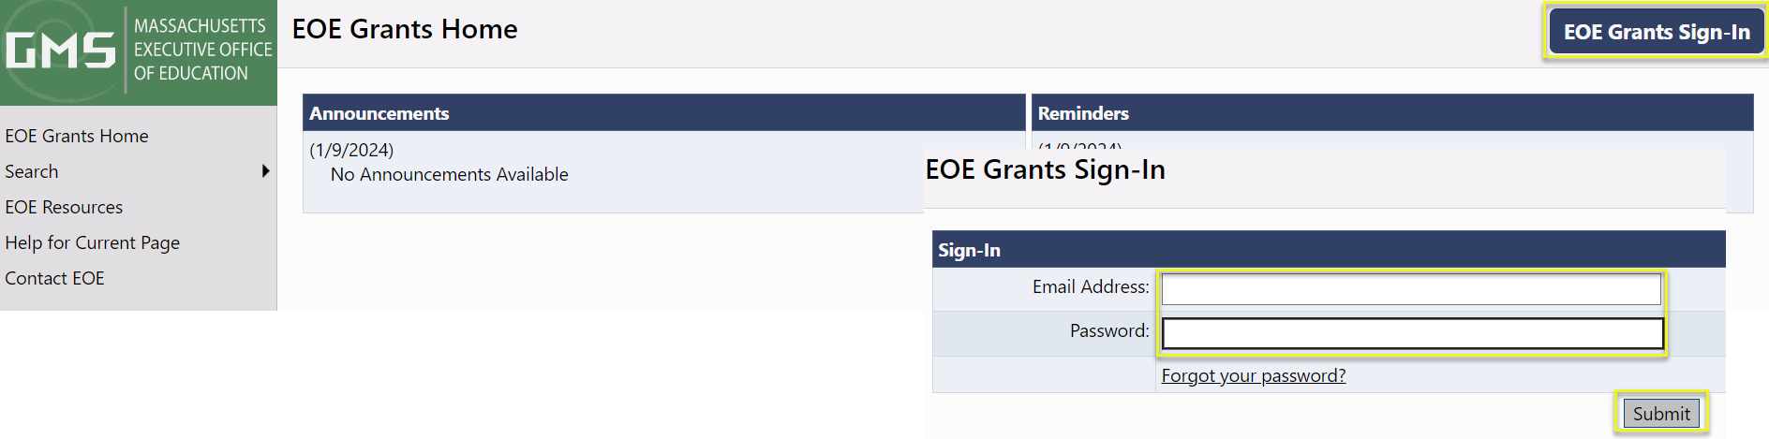
Accessing the System
The EOE Grants site URL is https://masseoe.egrantsmanagement.com/
Click “EOE Grants Sign-In.”
Enter your Email Address and Password. Click “Submit.”
When needed, use “Forgot your password?” to reset your password.

Slide 10
The Navigation Menu
Administer – Only available for users with admin permission
Inbox – Users’ record of system emails
Funding – Access to funding applications
Reimbursement Requests – Access to payment requests
Grantee Document Library – A collection of documents from grantees--not tied to funding applications
Address Book – an organization’s list of users with Grantee and SEA roles
EOE Resources – A library of training and program guidance documentation (managed by EOE)
Help for Current Page – Page specific instructions
Contact EOE – Information to request system assistance

Slide 11
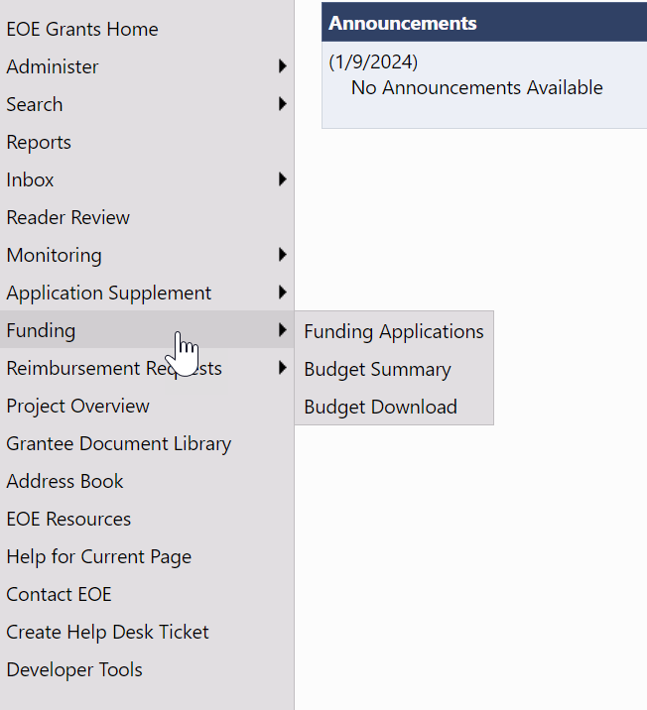
Navigation Menu and Tips
The left menu allows for quick navigation between EOE Grants components.
From the menu, hover over menu items with arrows to view sub-menus.
Use the EOE Grants navigation links; not your browser’s Back button.

Slide 12

Session Timeout
The system timer is located in the
upper right corner of the screen.
The timer is set for 60 minutes.
Users will want to save often so as not to lose data entered when the timer expires.
To reset the session timer:
  Click on any link in the application.
  Use the “Go To” or “Save and Go To” navigation to another page or stay on the current page.

Slide 13
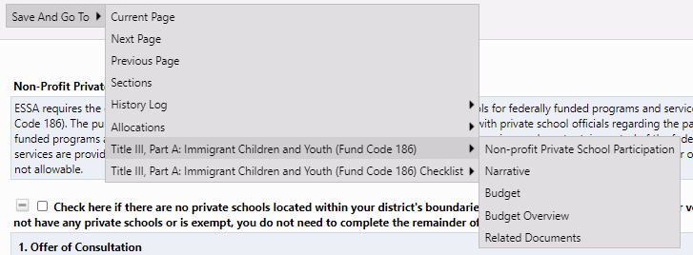
Saving and Navigation
Use the / Save and Go To menu options to save your work and to navigate between pages in a funding application.

Slide 14
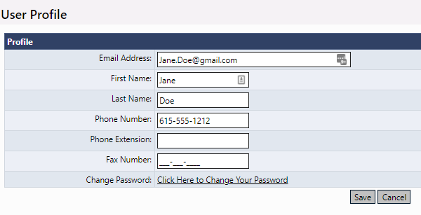
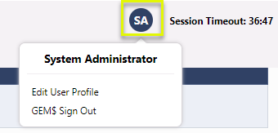
Modify User Profile
To modify your User Profile, click your initial avatar, then “Edit User Profile” to update your information or change your password.

