Slide 1
EOE Grants (E-Grants)
Executive Office of Education (EOE)
Training Module 2
Funding Applications

Slide 2
Agenda
Landing Pages and General Navigation
Site-Level Funding Applications
The Budget
Program Details
Related Documents
Submission and Review Workflow
Other EOE Grants functionality

Slide 3
Landing Pages and General Navigation

Slide 4

Organization Main Page
Once a user is logged into the system, the screen to access an organization is displayed.
To navigate to the grantee’s Funding Applications page, click the link for the Organization under “Organization Name.”

Slide 5
For Users in Multiple Organizations
For users who will use EOE Grants for multiple organizations, EOE Grants will display the names of the available organizations in a list under “Organization Name.”
Choose the appropriate organization from the main landing page to edit work for that organization.
To change to another organization, click on the “EOE Grants Home” menu item in the upper-left corner of the navigation menu to return to the listing of the organizations to choose from.

Slide 6
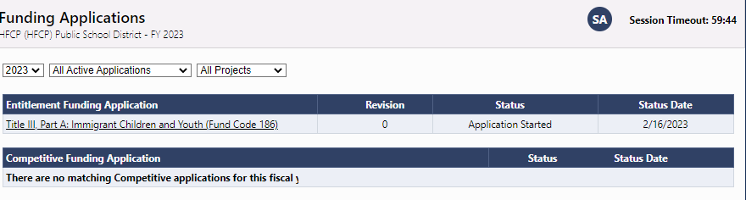
Funding Applications Main Page
Each organization has a main Funding Applications page.
Accessible from “Funding” on the left navigation once you have an organization in your session
Launching point to all of a organization’s grant applications
Contains View filters
  Fiscal Year & Application Status filter

Slide 7
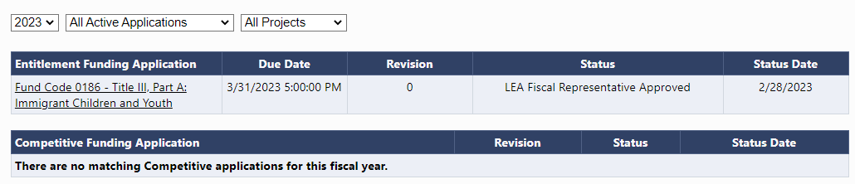
Funding Applications Main Page
Useful information on this page includes:
Entitlement versus Competitive application
Some applications display a Due Date.
Revision #
Application Status & Status Date

Slide 8
The Sections Page
The Sections page is an overview of a selected funding application.
It is the launching point to pages within the application.
You may view the sections as expanded or collapsed.

Slide 9
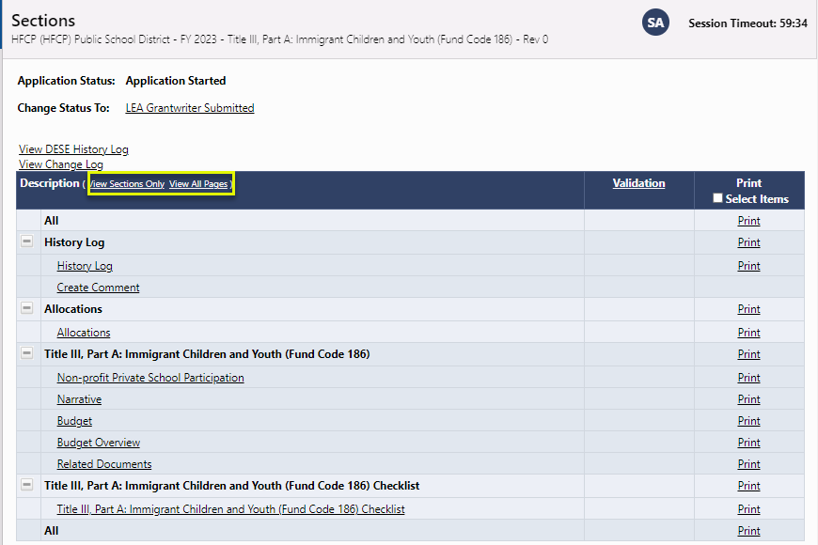
The Sections Page

Slide 10
Sections
“Sections” are a consistent structure across EOE Grants applications and reimbursement requests.
  Status changes
  History Log and Comments
  Allocations
  Grant sections
  General sections
  Validation: Error and Warning messages
  Print
  Revision Details (on revisions > 0)
  Checklist for SEA qualitative review

Slide 11
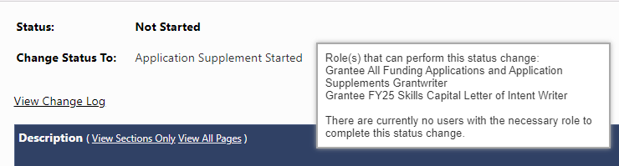
Understanding Statuses
The Sections page displays the current status of the application and the next possible status(es).
If the user lacks the correct permission, the status change confirmation screen will indicate so.
Hover on the status change link for hints on role(s) required to change status and user(s) who can perform the status change.
To begin work on a funding application or Application Supplement, the user must click the link “Application (Supplement) Started.”

Slide 12
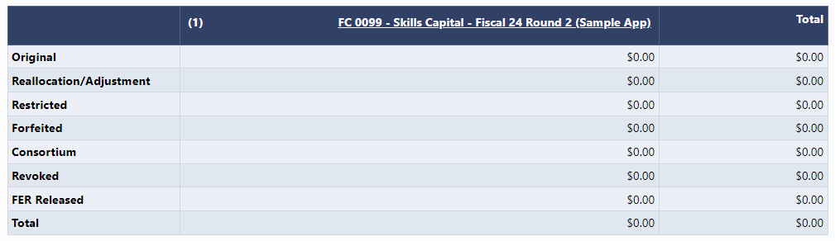
The Allocations Page
This page displays the allocation(s) for each grant in the funding application.
It is broken out by Allocation Type.

Slide 13
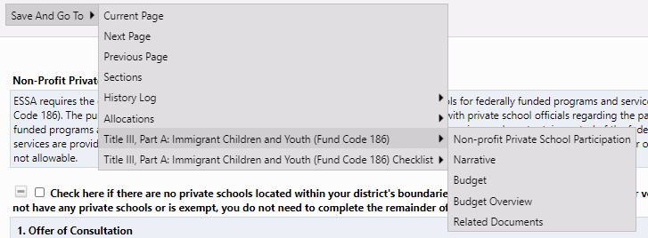
Funding Application Page Navigation
Go To / Save and Go To menu options allow navigation between any pages in the funding application.

Slide 14
Save and Go To…continued
Using Save and Go To refreshes session timeout.
Save and Go To Current Page: Saves changes to the page and keeps user on that page.
Save and Go To Next Page: Saves changes to the page and moves user to next page in that section.
Save and Go To Previous Page: Saves changes to the page and moves user to previous page in that section.
  If no previous or next page exist, the user is returned to Sections page.

Slide 15
Page Locking
EOE Grants prevents multiple users from editing the same page simultaneously.
  User will see message indicating that the page is locked by another user.
  The lock is released after that user leaves the page or the session times out.

Slide 16
Demonstration

Slide 17
Site-Level Funding Applications

Slide 18
Site-Level Funding Applications
Most of the funding applications in EOE Grants will be “organization-level” (meaning parent-level) applications where the funding will exist in one budget.
For site-level grants, budgeting is done at the site level. Applicants will enter a budget for each site and the system will total the budgets for all of the sites into one organization-level budget.
An example of this functionality is for Skills Capital grants where the grantee may provide funding to support programs at multiple sites.

Slide 19
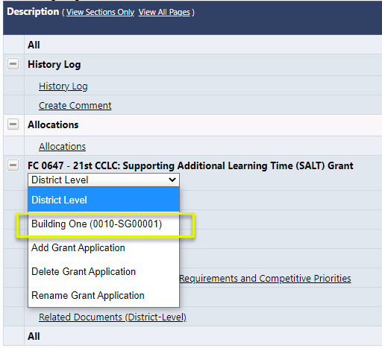
Site-Level Funding Applications (2)
The dropdown selector in the middle of the Sections page allows the user to toggle between the grantee (parent organization) view and the site-level view.

Slide 20
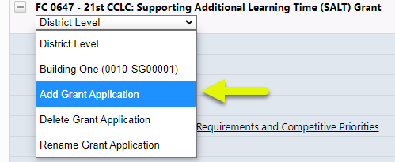
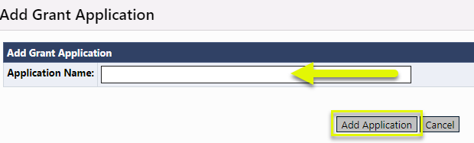
Site-Level Funding Applications (5)
To add, delete, and edit site names, use the options in the dropdown selector.

Slide 21
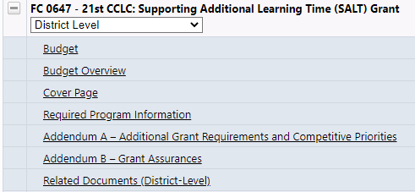
Site-Level Funding Applications (3)
When the selector is set to “Organization/District Level,” all of the pages displayed on the Sections page apply to the district (or parent-level organization).
The Budget link shown here will display a read-only page.

Slide 22
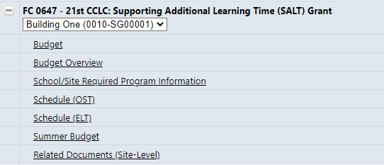
Site-Level Funding Applications (4)
When the selector is set to the name of the site, the links displayed will be to the pages that are required for each site.
Note that even if the organization only has one site, completing these pages for that site is required.

Slide 23
Demonstration

Slide 24
The Budget

Slide 25
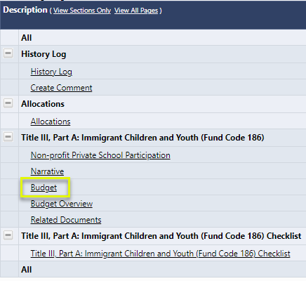
Budgeting
To begin budgeting, click on the “Budget” link on the Sections page.

Slide 26

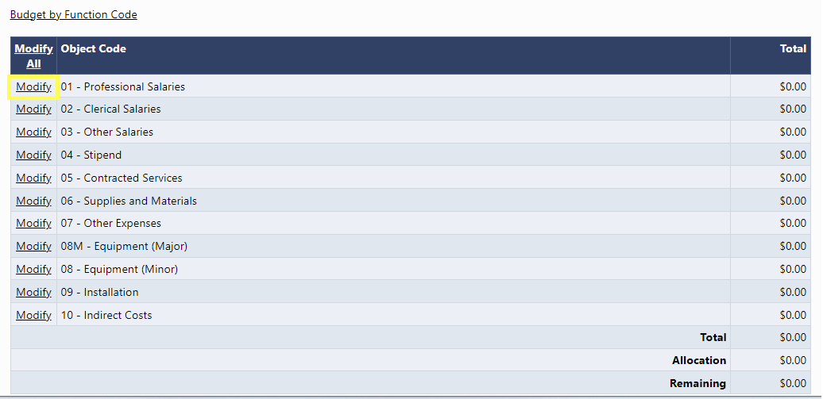
The Budget Page
Click on the “Modify” link to begin budgeting.
Note that users may choose to budget by Object Code or by Function Code.

Slide 27
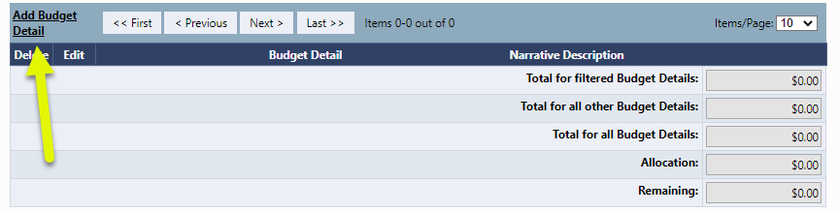
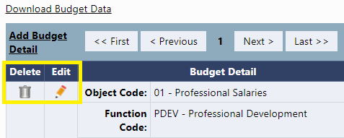
Budget Detail
Click on “Add Budget Detail” to create a new Budget entry. To edit an existing entry, use the pencil or the trash can icon.

Slide 28
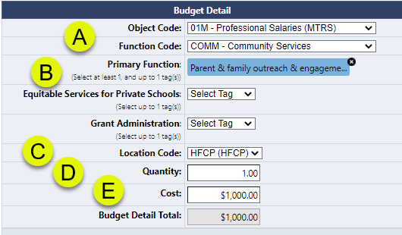
Add/Edit Budget Detail
Select the Object & Function Codes;
Some grants may have optional or required budget tags – some tags allow multiple selections;
The Location Code must be selected (defaults to the parent organization);
Quantity defaults to 1;
Cost greater than $0.00 must be entered; the system calculates the Budget Detail total.

Slide 29
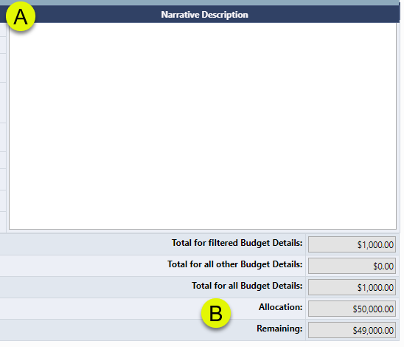
Budget Details (continued)
For most grants, Narrative Descriptions are required.
Note that the system tracks the funds budgeted against the allocation.

Slide 30
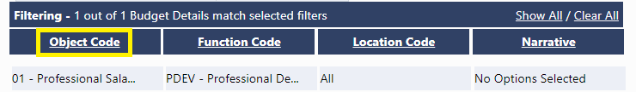
Budget Detail Filters
The hyperlinks in the Filtering portion of the Budget Details screen allow the user to view their budget entries using filtering.

Slide 31
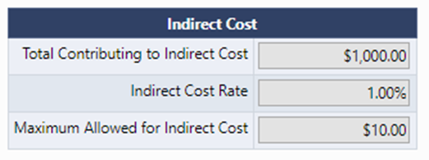
Indirect Cost
For grants that allow indirect cost:
As the user budgets, the system tracks the amount of allowable indirect cost, based on the grantee’s indirect cost rate.
The system accounts for budget items that do not contribute to indirect cost.
The user will not be able to submit the application if the amount budgeted for indirect cost exceeds what is allowable.

Slide 32
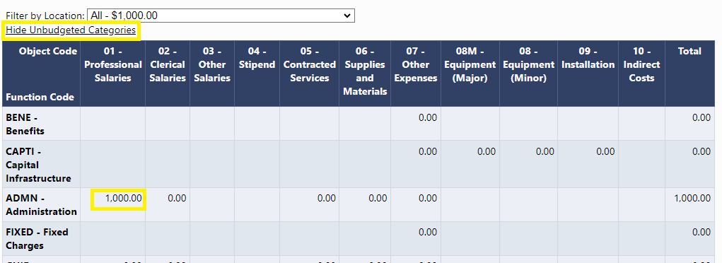
The Budget Overview
The Budget Overview screen is a convenient way to view the budget. This is a read-only page.
Use the Show/Hide Unbudgeted Categories to toggle the view of the budget.

Slide 33
Demonstration

Slide 34
Program Details Pages

Slide 35
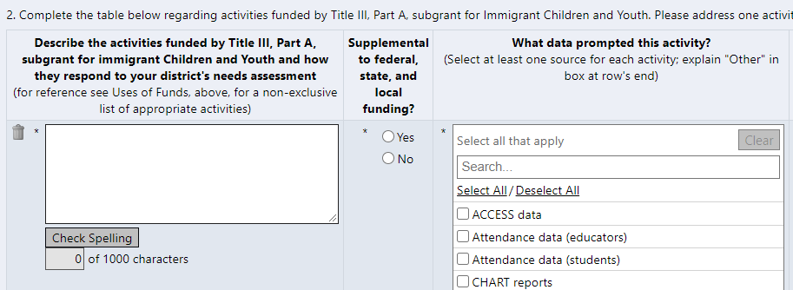
Program Detail Pages
Program Details pages provide information about a grantee’s application beyond what is captured in the budget.
Detail items marked with an asterisk are required in order to submit the application.

Slide 36
Program Detail Pages
Common Types of Data
  Numeric / Integer
  Short Text response
  Narrative – Rich or Plain Text
  Dropdown List / Radio Buttons
  Checkboxes
  Checkboxes that enable or disable a subsequent range of questions
  Date Picker
  Grids allowing multiple responses (“Add a Row”)
  Document Uploads
  Read-only fields calculating amounts based on entries in other fields
  Read-only grant-specific values populated by EOE Grants

Slide 37
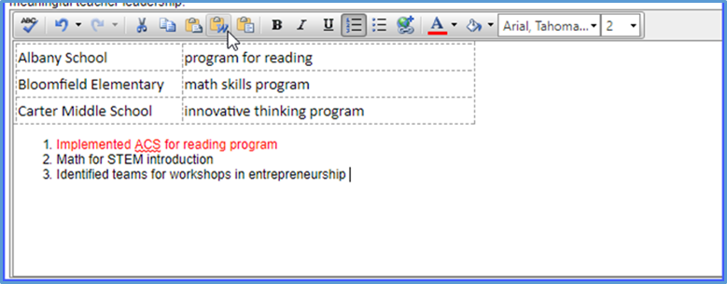
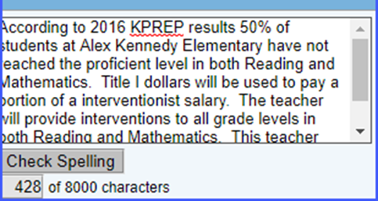
Text Boxes
Format Text from the toolbar
Copy and Paste formatted text
Spell Check
Large amounts of text
Copy and Paste text only
Spell check
Limited to # of characters

Slide 38
Related Documents

Slide 39
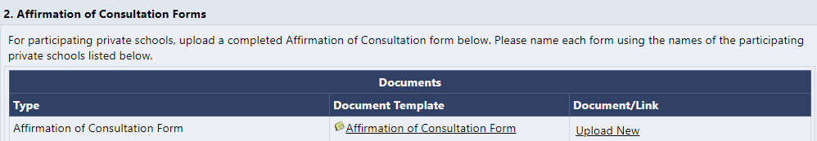
Related Documents
EOE may request that grantees attach additional documentation to funding applications.
Documents may be required or optional.
EOE may provide a document template.

Slide 40
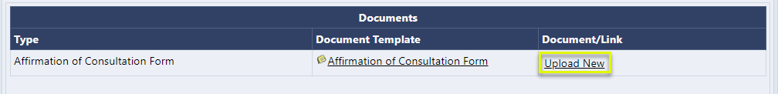
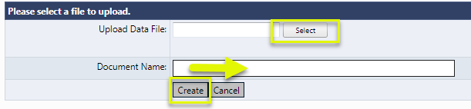
Adding a Related Document
To upload a Related Document:
Click the “Upload New” link.
Browse for the file to upload.
Enter a Document Name.
Click “Create.”

Slide 41
Demonstration

Slide 42
Submission and Review Workflow

Slide 43
Validations
Validations are checks built into the system based on business rule checks put in place to ensure the quality of the data being submitted.
The system automatically checks validation as the application is being submitted.
The presence of validation issues is indicated on the Sections page, in the Validation column.

Slide 44
Types of Validations
There are two types of validation messages:
  Errors: prevent submission of the application
  Warnings: point out potential issues but allow submission
  Examples of errors include:
  Not completing a required narrative question
  Budgeting more than the allocation
  Not uploading a required related document
  An example of a warning is:
  Not uploading an optional related document

Slide 45
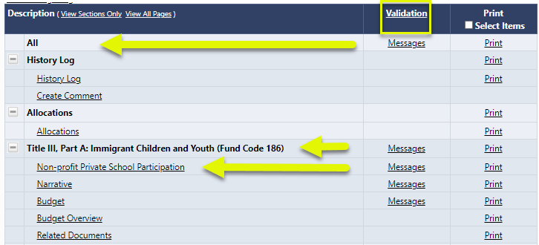
Viewing Validations
Validations can be viewed at the page, section, or application level.

Slide 46
Validations Clarifications
The system does not prevent the entering and saving of “invalid” data; it prevents the submission of invalid data.
Validation checks can span multiple pages.
“Invalid” data can become valid based on
subsequent input.

Slide 47
Editing, Submitting, and Reviewing
Once the application is complete, the Grantwriter will move the application to “Grantwriter Submitted.”
Then the Fiscal Representative will review.
If the Fiscal Rep approves, the application will move to EOE review.
If EOE returns the application to the Organization for modification, the Grantwriter will need to make the requested changes and resubmit the application.

Slide 48
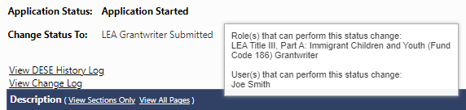
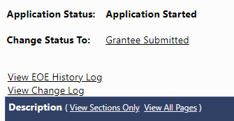
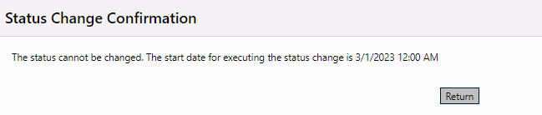
Submission and Review Workflow
The system performs prerequisite checks
  Does the user have permission?
  Does the time frame allow for this status change?

Slide 49
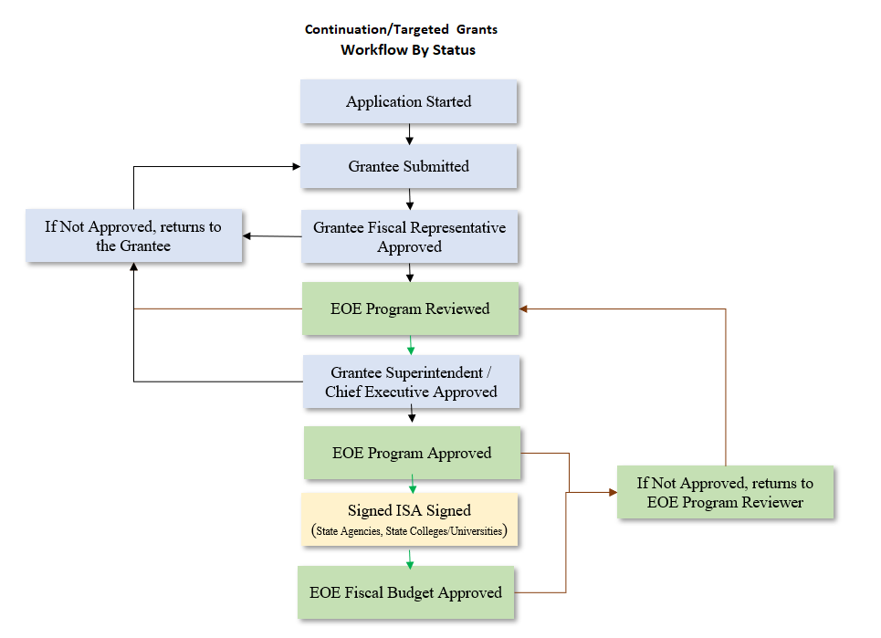

Slide 50
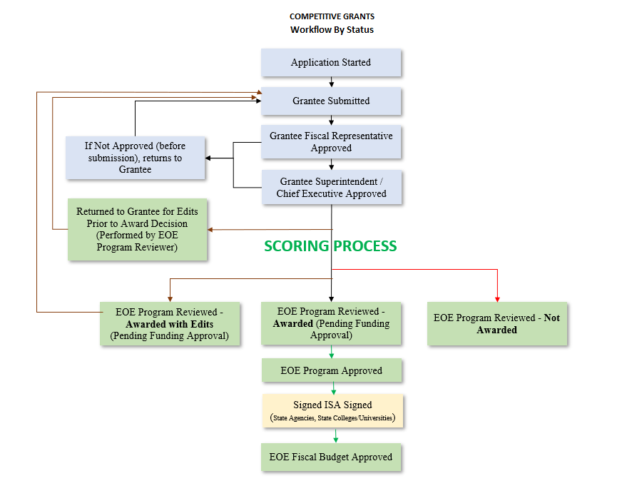

Slide 51
Status Change Outcomes
The status change is noted in the History Log documenting the date, time, and username.
The next person in submission workflow is notified by email that the application now requires their attention.
The application may be locked down or unlocked (depending on the status change).

Slide 52
Demonstration

Slide 53
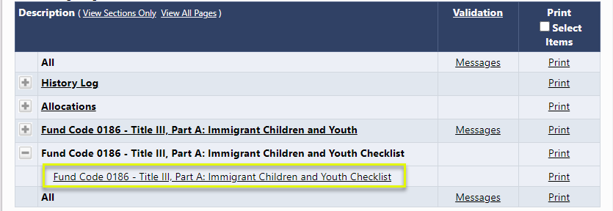
The Checklist
For funding applications that are using a checklist:
This checklist is a means of communication between EOE and grantee regarding the allowability and allocability of the items submitted in the funding application.

Slide 54
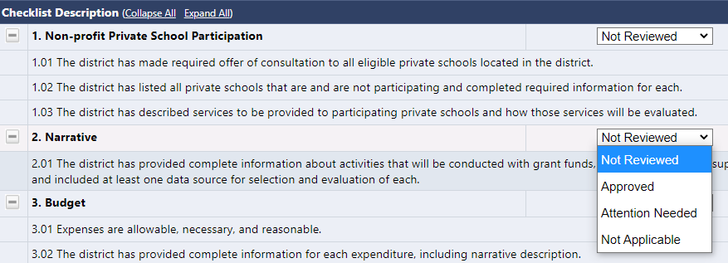
How The Checklist Works
After the Organzation submits the application, EOE will review the application and mark each section as Approved, Not Applicable, or Attention Needed. If the application contains no items that are marked as Attention Needed, the application will be approved.

Slide 55
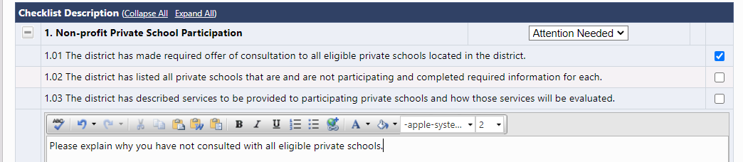
EOE Comments in The Checklist
If the application contains items that are marked as Attention Needed, the application will be returned to the grantee with a status that is not approved. The grantee will review the checklist for items that are marked Attention Needed and make the necessary changes to those items. Only the checked items in the sections marked Attention Needed are to be corrected and/or explained. Each section marked Attention Needed also has a place where EOE may provide notes to explain those items. The grantee should check for notes and additional comments.

Slide 56
Moving to the Next Status
Once the grantee has made the necessary adjustments, they will resubmit the application for approval. If EOE determines that the item has been corrected, Attention Needed will be changed to Approved by the EOE Reviewer. If the items that were marked Attention Needed still have not been corrected, the application will be returned again to the grantee with a status that is not approved.
Applications that contain no items that are marked Attention Needed will be approved.

Slide 57
Demonstration

Slide 58
Other EOE Grants Functionality

Slide 59
Create Comments
Comments can be used to facilitate ongoing notes and discussion between EOE and the Grantee.
Comments can be made by anyone with access to the application at any time, regardless of application status.
Comments can be emailed to intended recipients.
Comments are saved within the funding application.
Comments are not visible to public users.

Slide 60
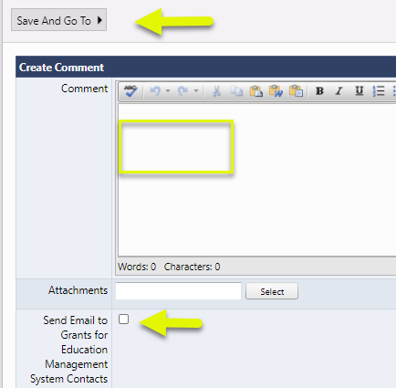
To Create a Comment
Click on “Create Comment” on the Sections page for the application you wish to comment.
Enter comment text.
Upload a document if desired.
If sending as an email, check the box.
Click “Save and Go To.”

Slide 61
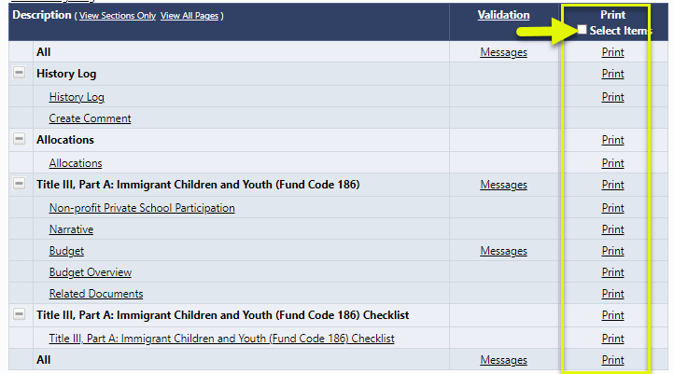
Printing
Users may print the application at the page, section, or full application level. They may also click the checkbox at the top of the column to select distinct pages.

Slide 62
Retrieving the PDF
The system will generate a PDF document, containing the selected pages.
Note the PDF will not include uploaded related documents.
The system will ask the user for an email address.
If the print job is small, the user may automatically retrieve the PDF document from the link at the top of the EOE Resources page.
If the print job is large, the system will send an email when the print job is ready to retrieve.

Slide 63
Demonstration

Slide 64

Reviewing Revision Details
Revision Details displays changes that have occurred to this current revision of the application relative to the previously approved application.
Each message contains a clickable “Review” link.
Clicking the link will show the user to the page where the change occurred.

Slide 65
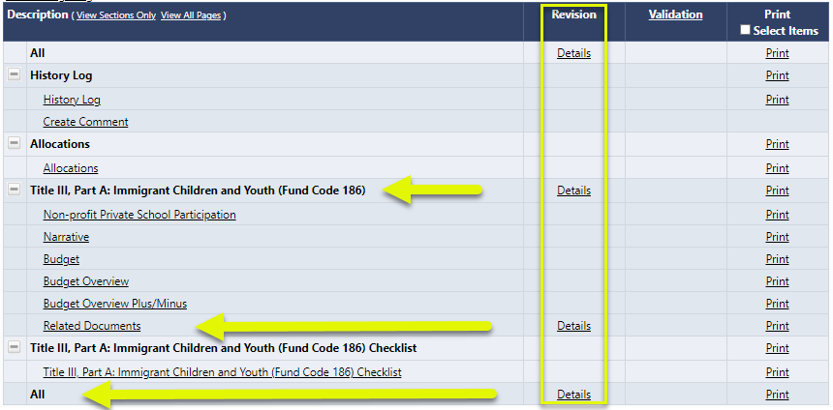
Viewing Revision Details
Revision Details can be viewed at the page, section, or application level.

Slide 66
Reviewing the Address Book
It is best practice to review the roles in your organization at least annually to determine if changes need to be made. A quick way to see who has roles in your organization is to access the Address Book.
The Address Book is accessed from the EOE Grants main menu using the left-hand navigation.
Funding Application

Slide 67
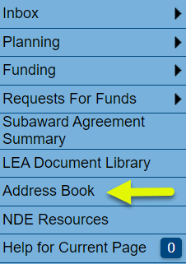
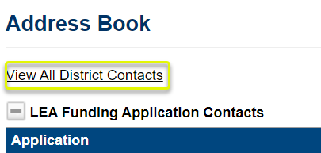
Reviewing the Address Book (2)
To review the Address Book:
Click on “Address Book” from the main menu.
Use the toggle link “View All District Contacts” and “Return to Address Book” to view user/role information within the Grantee.
Funding Application

Slide 68
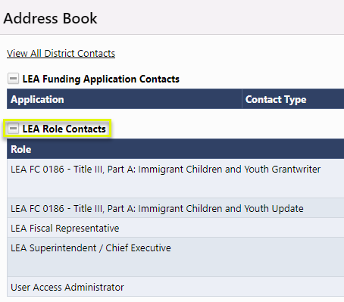
Address Book Headings
Here are some main headings of users within the Address Book that are most helpful to view user listings:
Grantee Role Contacts lists all Grantee roles with users who are assigned to each role.
Funding Application

Slide 69
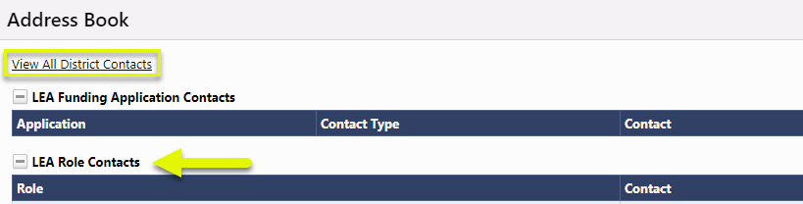
Address Book Headings
After clicking on View All District Contacts:
District Contacts lists all current OrganizationA users arranged alphabetically by last name.
Funding Application

Slide 70
Address Book Headings
EOE Funding Application Contacts lists EOE Grants users who have been designated as state-level contact(s) for each funding application by EOE. This is a good place to look if you have a program question about a specific funding application.
Note that user contact information (such as email address and phone number) becomes visible when clicking on the link for the name of the contact.
Funding Application

Slide 71
Demonstration

