Slide 1
EOE Grants (E-Grants)
Executive Office of Education (EOE)
Training Module 3
Reimbursement Requests

Slide 2
Agenda
Reimbursement Request (RR) Entry Screen
Project Summary / Reimbursement Request List
Creating and Completing Reimbursement Requests
Reimbursement Request Approval Steps
Search Reimbursement Requests

Slide 3
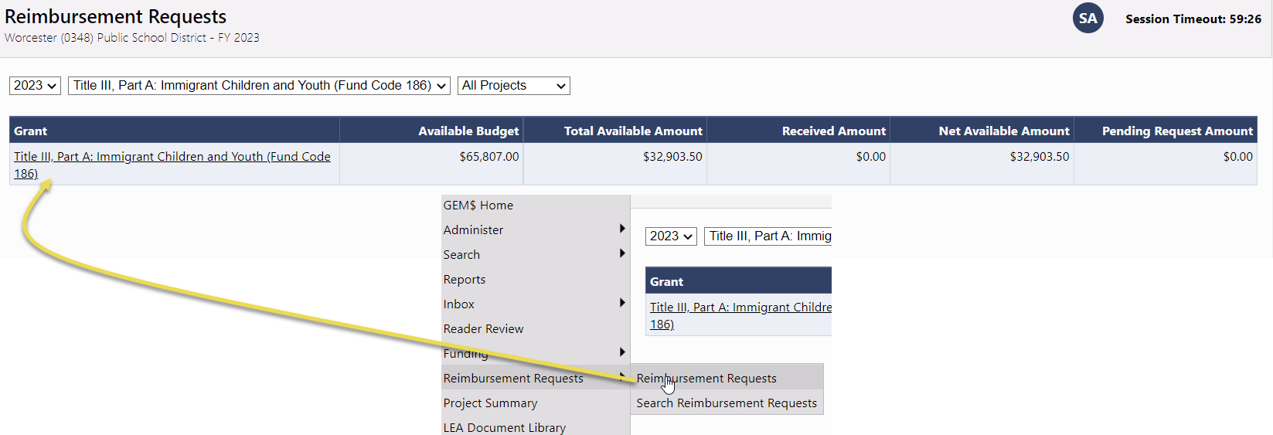
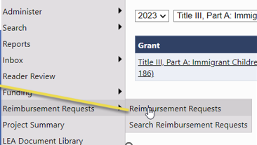
Reimbursement Request Entry Page
Access from Left Nav: Reimbursement Requests >> Reimbursement Requests
Choose FY, Funding Application, and Project Status (Note: All is available)
Available Budget: Lesser of Approved Budget and Pending Allocation
Total Available Amount: Factors in Funding % of Allocation Sources
Net Available Amount = Total Available – Received Amount
Pending Fund Requests shows an amount when there is an RR in progress or ‘None’ when no pending RR

Slide 4
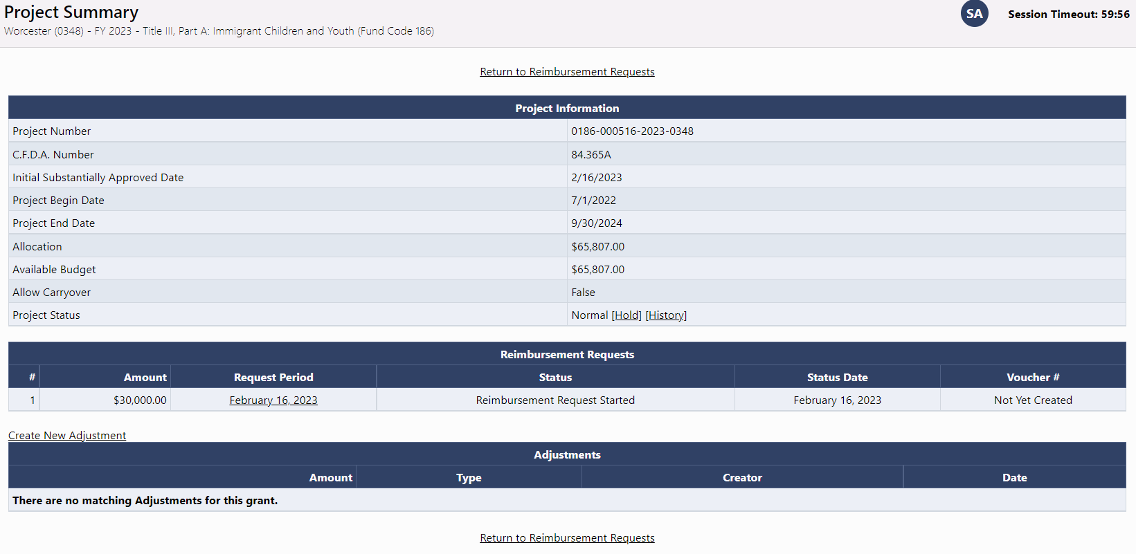
Project Summary / Reimbursement Request List
Displays general grant information
List of Requests for this grant
List of Adjustments for this grant
Project Hold Administration

Slide 5
Demonstration

Slide 6
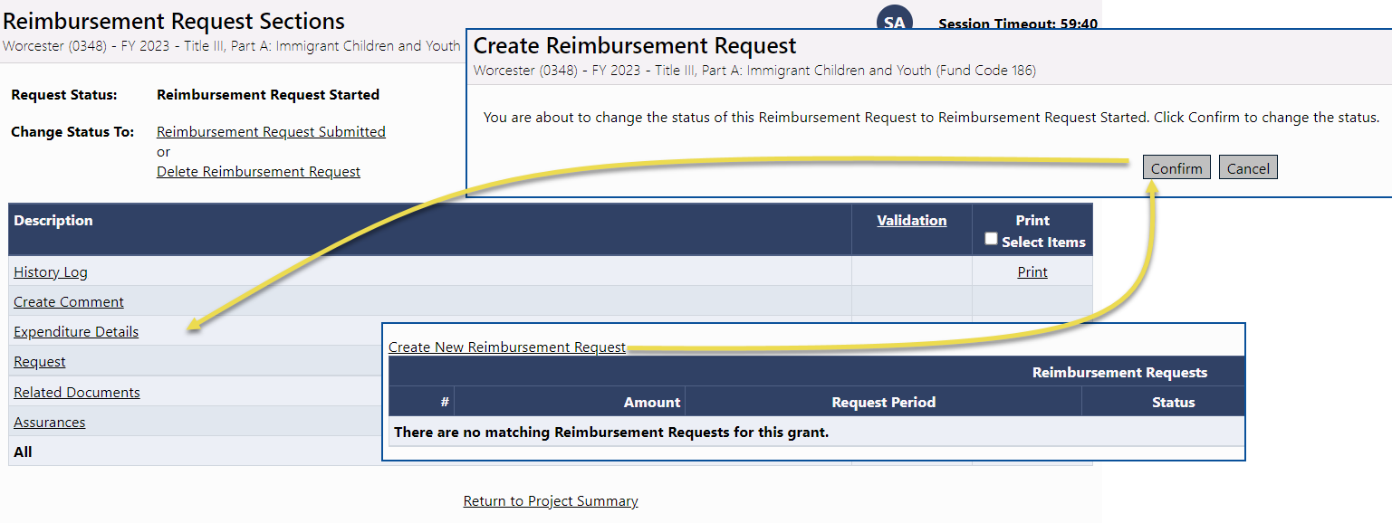
Creating and Completing Reimbursement Requests
Reimbursement Requests cannot be created until the grant budget is approved
One active reimbursement request per Grantee/Grant/FY combination
General Framework consistent with Funding Application
  Sections
  History Log and Communication
  Validation
  Workflow

Slide 7
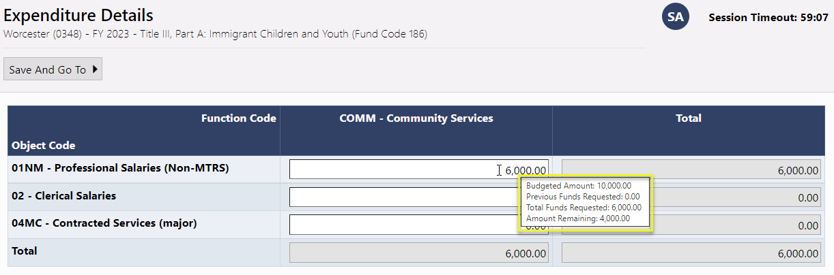
Expenditure Details Page
Report Project-to-date Expenditures by Object and Function Item
Only displays rows and columns that contain approved budget amounts
EOE Grants validates expenditures against approved budget
Hover on cell to see approved budget amount
Disabled cells where no approved budget exists
Automatically populates expenditures from previous request
  Just update cells that have changed

Slide 8
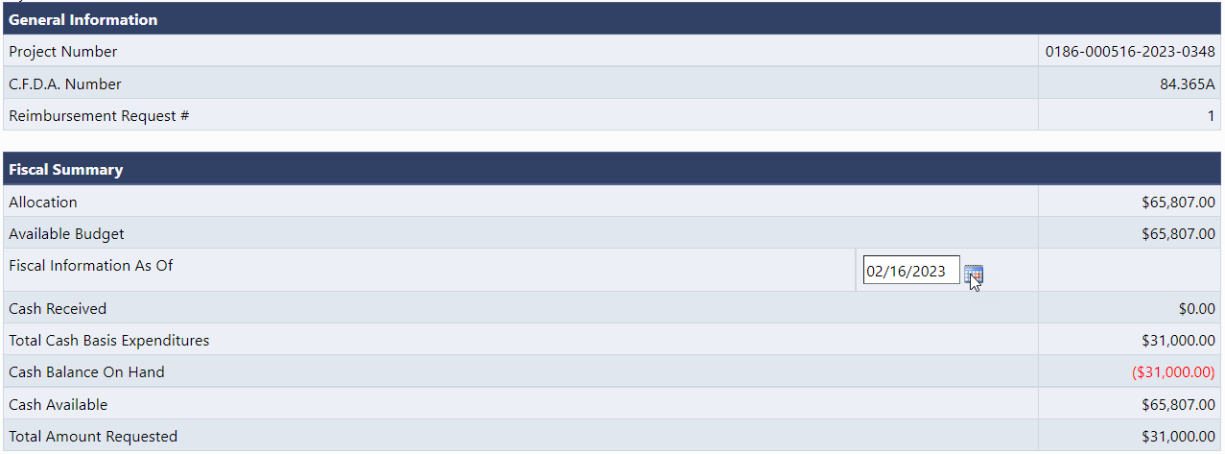
Request Page – Fiscal Summary
System knows and automatically populates most fields
Total Cash Basis Expenditures comes from Expenditure Details page
Calculates amount of the request automatically using total expenditures minus cash received

Slide 9
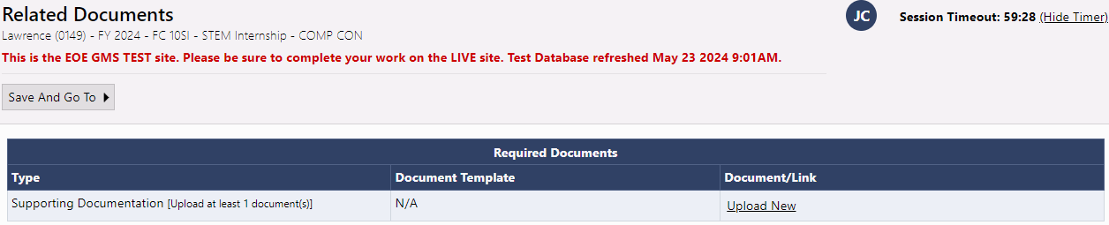
Related Documents Page
Grantee is required by EOE to upload backup documentation detailing their expenditures
Document types allowed include PDF, Word, Excel, PowerPoint

Slide 10
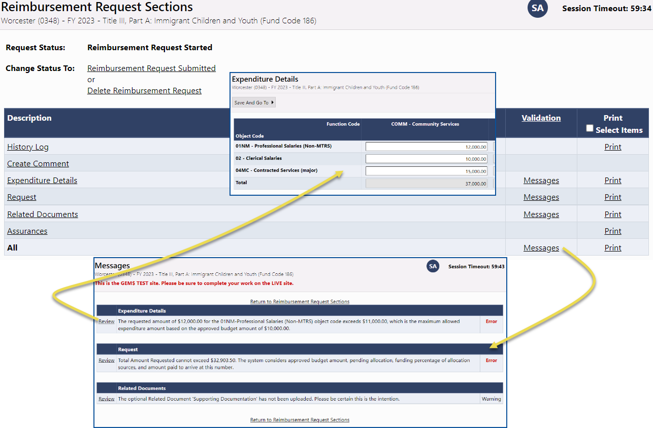
Validation
System automatically validates Reimbursement Requests as they are completed
Errors will prevent submission; warnings will be called out but allow submission

Slide 11
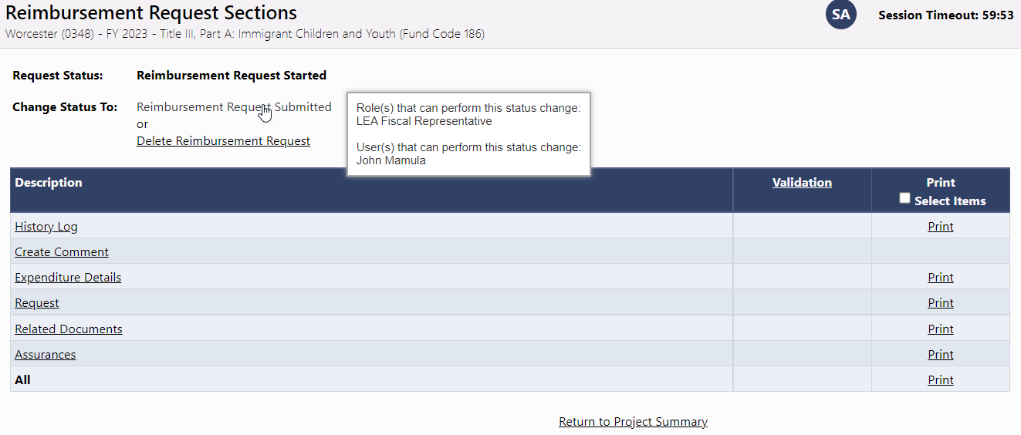
Submission and Review
Once an RR passes validation, the Grantee Fiscal Representative may move it to Reimbursement Request Submitted
RR is then sent to EOE for EOE Fiscal Payment Review

Slide 12
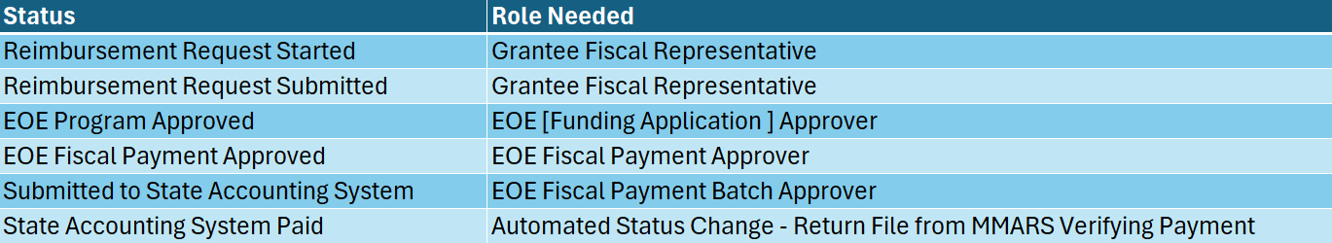
Reimbursement Request Approval Steps

Slide 13
Demonstration

Slide 14
Critical Notes about Reimbursement Requests
Reimbursement requests are created and submitted by the Grantee Fiscal Representative
Grantee must enter project-to-date expenditures
Grantee will need to do a budget revision when they have expenditures in an unapproved Object Code / Function Code combination (cell) or they exceed their approved budget for a cell by more than 10%

Slide 15
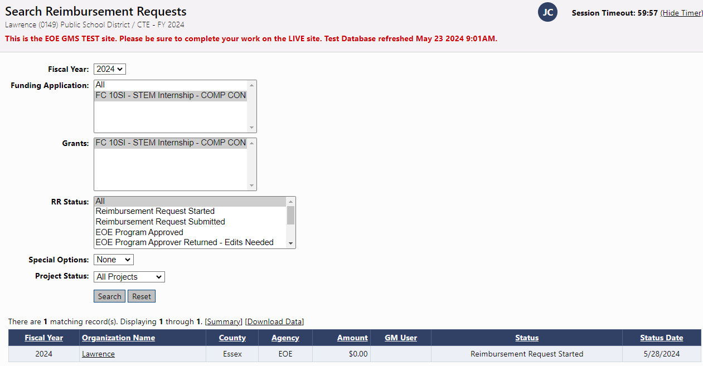
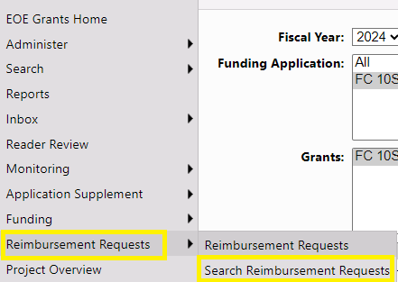
Search Reimbursement Requests
Grantees have a search tool that will allow them to quickly find Reimbursement Requests

Slide 16
Demonstration

