Slide 1
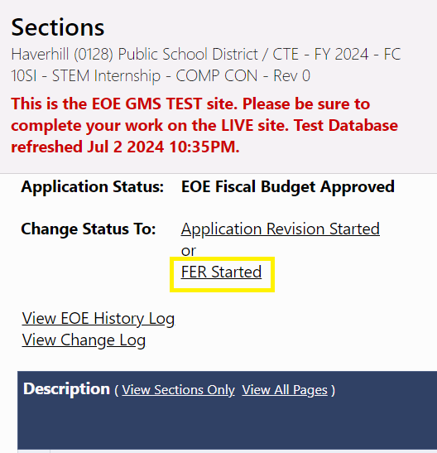
Starting the Final Expenditure Report (FER)
FER Started is available as next step on applications that are in final approval (typically EOE Fiscal Budget Approved)
Will not be allowed until after the grant project end date or all funds have been paid
Must be initiated by the Grantee Fiscal Representative
All pending Reimbursement Requests must be in a paid status
Grantee may not submit any further Reimbursement Requests
No more budget revisions will be allowed to
this funding application!!! (FER can be cancelled by EOE Fiscal FER Approver – this opens the application up for more budget revisions)

Slide 2
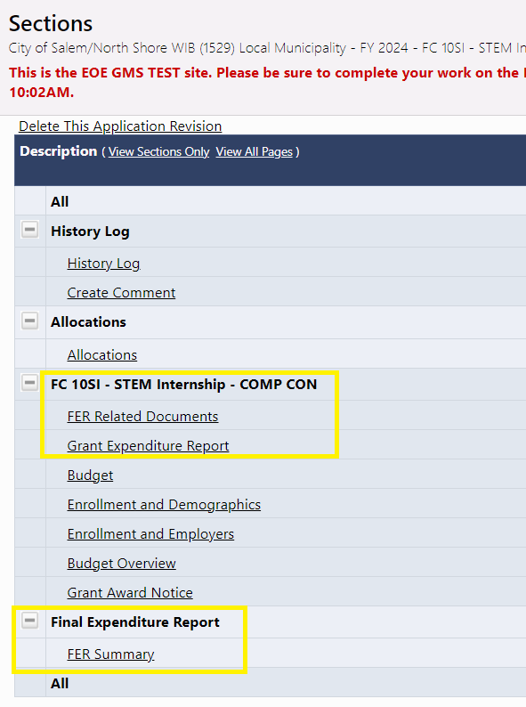
Navigating the FER
Once in FER status, user will notice several changes:
New “Grant Expenditure Report” page at top of each grant section
New “Final Expenditure Report” section with "FER Summary" page
Other application pages will not be editable

Slide 3
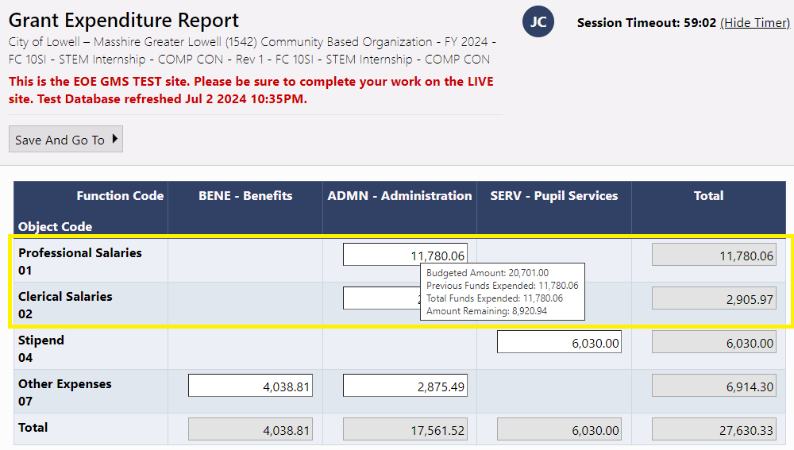
Grant Expenditure Report Page

Slide 4
Grant Expenditure Report Page
Page should be completed for each grant in the funding application
Loads object codes and function codes for which grantee has approved budget
Prefills with expenditures from most recent Reimbursement Request
  LEA should update as appropriate
Hover mouse on cell to see approved budget amount for that cell
Allows up to 10% overage on individual cells
Total expenditures for grant cannot exceed approved budget for that grant

Slide 5
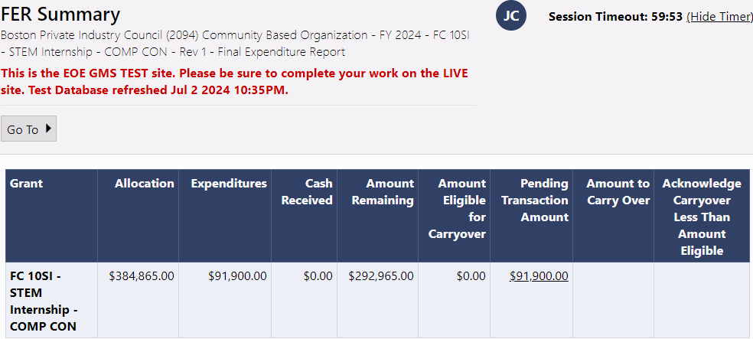
FER Summary Page
Summarizes allocation, expenditures, amount paid, remaining amounts, and pending transactions (Reimbursement Request or a Refund Due) for all grants in the application
Carryover columns are not applicable for your agency

Slide 6
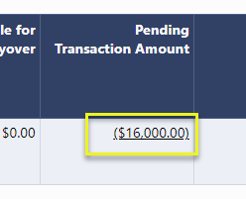
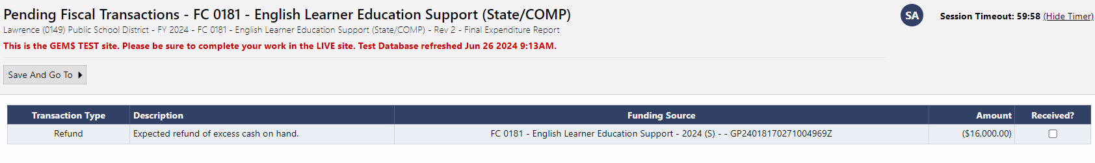
Pending Transaction Amount Page
When you click on the amount in the Pending Transaction Amount, the system displays the transaction that will occur when the FER is processed
The transaction may be a Reimbursement Request or a Refund Due – in many cases there may be no transaction necessary

Slide 7
FER Workflow Steps
  FER Started - Grantee Fiscal Representative
  FER Submitted Grantee Fiscal Representative
  FER EOE Fiscal Budget Primary Approved - EOE Fiscal FER Approver
    Used when a refund is due from the Grantee
  FER EOE Fiscal Budget Final Approved - EOE Fiscal FER Approver
    Creates the Reimbursement Request if needed

Slide 8
Useful FER Reports
Refunds Due
  Returns any refunds that are due because of the FER process
  Includes the details on the most recent payments that will be used to rollback funds
Miscellaneous Adjustments
  Returns any miscellaneous adjustments that have occurred in the system
  Allows you to search by miscellaneous adjustment type

